Slide 1

Ferromagnetic Pipe Climbing Robot using Raspberry Pi
A
Seminar
Presentation
in partial fulfillment for the award of the degree of
Bachelor of Engineering
(Electronics Engineering)
Under the Guidance
Mr. Choudhary S.K.
Electronics Engineering Department
Submitted By
Naikwadi Yash Rajendra
Todkar Arthesh Rajendra
Gunjal Om Shashikant
Electronics Engineering Department
Electronics Engineering Department
Amrutvahini College of Engineering, Sangamner
2023-24

Slide 2
Content
Infrastructure Inspection and Maintenance:
The primary context is the need for efficient and effective inspection and maintenance of infrastructure, particularly pipelines. Traditional methods often involve manual inspection or expensive specialized equipment. A climbing robot provides a more versatile and cost-effective solution.
Ferromagnetic Surfaces:
The focus on ferromagnetic surfaces is due to the prevalence of materials like steel in pipeline construction. By leveraging the magnetic properties of these surfaces, the robot can adhere securely, allowing it to navigate vertical or horizontal pipes.
Automation and Autonomy:
The integration of a Raspberry Pi brings a level of automation and autonomy to the robot. The Raspberry Pi serves as the brain of the robot, processing sensor data and making decisions to control the robot's movements. This autonomy is crucial for the robot's ability to navigate pipes without constant human intervention.
Sensor Integration:
Sensors play a crucial role in the context of the project. Sensors such as proximity sensors, accelerometers, gyroscopes, and potentially a camera are integrated into the robot to collect data about the pipe's condition, detect obstacles, and enable navigation.
Data Acquisition and Analysis:
The robot is designed not only to move along the pipe but also to collect and transmit data. This data may include information about the pipe's structural integrity, potential signs of corrosion, temperature, or any anomalies. The Raspberry Pi processes this data for real-time decision-making and may also facilitate data storage for later analysis.

Slide 3
Introduction
Gas and oil tanks, wind turbines, pipelines and marine vessels are examples of the structures which are the target for the application of the ferromagnetic pipe climbing robot. Such structures are usually built from ferromagnetic material having a convex circumference and thus, utilization of magnetic adherence systems is a natural choice. Pole climbing robots received increasing attention during the previous years due to their application in the inspection of pipelines and similar structures. In order to hold itself to a smooth surface, the climbing robot can use suction cups, gripping mechanism and magnetic adhesive. In this project, we are using a magnetic adhesive type.
The ferromagnetic pipe climbing robot being designed for this project uses magnets to keep itself attached to the pipe while the motors and wheels system help to move the robot in the vertical or horizontal direction. DC motors are used as they provide 360 Degree of rotation for the wheels. The entire design and fabrication have been done while keeping in mind that the weight of the robot needs to be as low as possible.
Giving Magnetic Adhesion properties to the robot can be achieved by Permanent Magnets as well as Electro Magnet. Using an Electro Magnet was not an option due to its huge power consumption which would lead to heavier batteries and end up making the Bot so heavy that it would not be able to stick to Iron Surface.

Slide 4
Need of Project
Designing a Ferromagnetic Pipe Climbing Robot using Raspberry Pi can serve several practical purposes and address specific needs in industries like infrastructure inspection, maintenance, and repair. Here are some reasons why such a project could be valuable:
Remote Inspection:
A ferromagnetic pipe climbing robot equipped with sensors and cameras can provide remote inspection capabilities. This is especially useful in situations where manual inspection is difficult or dangerous.
Reduced Human Intervention:
In environments that are hazardous or challenging for humans to access, such as pipes in industrial settings or infrastructure, a climbing robot can reduce the need for human intervention.
Cost-Efficient Maintenance:
Regular inspection and maintenance of pipelines are crucial for preventing failures. A climbing robot can perform routine checks more cost-effectively than manual methods, reducing overall maintenance costs.
Versatility:
The robot's ability to climb ferromagnetic surfaces allows it to be versatile in different applications, such as inspecting pipes in various industries like oil and gas, water, or even in building maintenance.
Data Collection:
The robot can be equipped with various sensors to collect valuable data about the condition of the pipes. This data can be used for predictive maintenance, helping to identify potential issues before they become critical.

Slide 5
Idea of Project
Creating a Ferromagnetic Pipe Climbing Robot using Raspberry Pi is an exciting project that combines robotics, electronics, and programming. Design and build an autonomous climbing robot capable of inspecting ferromagnetic pipes for anomalies and defects in industrial settings. The robot will utilize Raspberry Pi as the central processing unit and incorporate a range of sensors for data collection. The goal is to enhance the efficiency and safety of pipeline inspections while providing a cost-effective and adaptable solution.
Raspberry Pi 4 Model B:
Acts as the brain of the robot, handling data processing, control algorithms, and communication.
Motor Control System:
DC gear motors and motor driver for precise control of the robot's movement on pipes.
Magnetic Adhesion System:
Strong neodymium magnets and an adjustable gripping mechanism for secure attachment to ferromagnetic surfaces.
Sensor Suite:
Ultrasonic sensors for thickness measurement and corrosion detection.
Infrared sensors for temperature anomaly detection.
Proximity sensors for obstacle detection.
HD Camera Module for visual inspection.

Slide 6
Aim
To create an autonomous and versatile robotic system capable of navigating and inspecting ferromagnetic pipes.
Objectives of Project
Autonomous Navigation:
Develop algorithms and control mechanisms that enable the robot to navigate ferromagnetic pipes autonomously, adjusting its position and grip as needed.
Magnetic Adhesion System:
Design and implement a reliable magnetic adhesion system with adjustable grips to ensure secure attachment to ferromagnetic surfaces, allowing the robot to climb pipes of various diameters and conditions.
Sensor Integration:
Integrate a suite of sensors for comprehensive inspection:
Ultrasonic sensors for measuring pipe thickness and detecting corrosion.
Infrared sensors for identifying temperature anomalies on the pipe's surface.

Slide 7
Literature Survey
Title: "Design and Development of a Climbing Robot for Inspection of Ferromagnetic Pipes"
Brief Information: This paper could cover the overall design, development, and functionalities of a climbing robot, specifically focusing on its application in inspecting ferromagnetic pipes. Look for details on the mechanical design, magnetic adhesion system, and sensor integration.
Title: "Autonomous Navigation Algorithms for Climbing Robots"
Brief Information: Explore papers discussing autonomous navigation algorithms applied to climbing robots. This could include path planning, obstacle avoidance, and adaptive control algorithms.
Title: "Magnetic Adhesion Systems for Climbing Robots: A Review"
Brief Information: Investigate papers that review various magnetic adhesion systems used in climbing robots. This can provide insights into the design considerations and effectiveness of different magnetic mechanisms.
Title: "Integration of Raspberry Pi in Robotics: A Survey"
Brief Information: Look for papers that provide a survey on the integration of Raspberry Pi in robotics projects. This could include discussions on control strategies, sensor interfacing, and communication protocols.
Title: "Wireless Communication in Robotics: An Overview"
Brief Information: Explore papers that give an overview of wireless communication technologies applied in robotics. This could include studies on Wi-Fi or Bluetooth-based communication systems.
Title: "Sensors for Pipeline Inspection: A Comprehensive Review"
Brief Information: Investigate papers that provide a comprehensive review of sensors used in pipeline inspection robots. This can include ultrasonic sensors, infrared sensors, and other relevant technologies.

Slide 8
Title: "Versatile Robotic Designs for Different Environments"
Brief Information: Look for papers discussing the design considerations and challenges in creating versatile robots capable of adapting to different environments, including ferromagnetic pipes.
Title: "Cost-Effective Solutions in Robotics: A Case Study"
Brief Information: Investigate papers that discuss cost-effective approaches in developing robotic systems. This could include considerations for reducing costs without compromising functionality.
Title: "Educational Impact of Robotics Projects Using Raspberry Pi"
Brief Information: Explore papers that discuss the educational aspects of robotics projects using Raspberry Pi. This could include insights into skill development, learning outcomes, and the impact of such projects in educational settings.
Title: "Advancements in Climbing Robot Safety Mechanisms"
Brief Information: Explore papers discussing safety mechanisms in climbing robots. This could cover emergency stop systems, fail-safes, and other features designed to ensure safe operation.

Slide 9
Literature Survey
Feature | Ferromagnetic Pipe Climbing Robot | Inuktun Versatrax 150
Navigation System | Autonomous navigation on ferromagnetic pipes | Remotely operated vehicle with articulated design
Power Supply | Rechargeable Lithium-Ion Battery Pack | External power source
Control Unit | Raspberry Pi | Remote control console
Magnetic Adhesion System | Adjustable magnetic adhesion system | N/A (not applicable)
Sensor Suite | Ultrasonic, Infrared, Proximity, HD Camera | High-quality inspection camera and optional additional sensors
Wireless Communication | Wi-Fi or Bluetooth | Wired remote control

Slide 10
Components
Raspberry Pi 3 B+ Model : ₹4,500
L298N Dual H-Bridge Motor Driver: ₹500
DC to DC Converter : ₹200
DC Gear Motors (4): ₹2,500
Wheels with Omni wheel (3+1): ₹1,500
Strong Neodymium Magnets: ₹1,100
Raspberry Pi Camera Module: ₹900
Rechargeable Lithium-Ion Battery Pack: ₹600
Battery Charger: ₹450
Aluminum or Acrylic Chassis Kit: ₹1,650
Motor Driver HAT for Raspberry Pi: ₹1050
Jumper Wires: ₹200

Slide 11
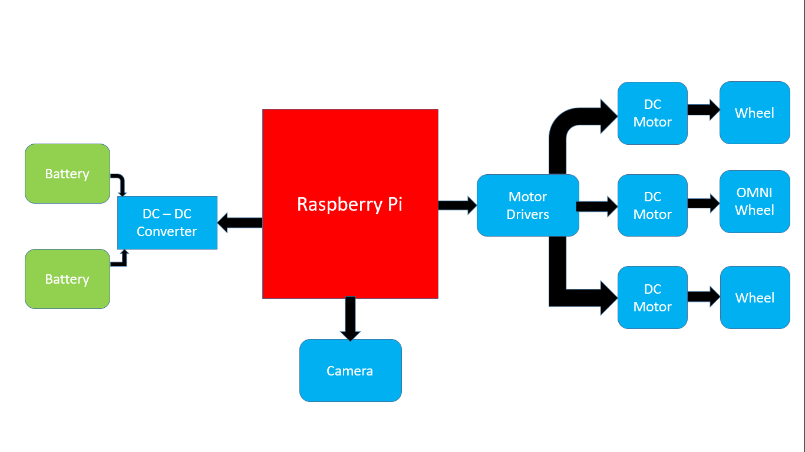
System Development
Block Diagram of Project

Slide 12
Continued…
The Raspberry Pi A+ is a credit card-sized computer. The Raspberry Pi Model A+ is a smaller, low-cost version of the Raspberry Pi. The Raspberry Pi Model A+ is recommended more for embedded and low-power projects that do not require Ethernet or multiple USB ports. It can be used for many of the things that a normal PC does, including using high-level computer programming languages (like Python), acting as a USB host, and operating system multitasking. Having the Wi-Fi and Camera Interface makes it an ideal choice for FPV Video Streaming.
The batteries used are Li-ion batteries. They’re generally much lighter than other types of rechargeable batteries of the same size. The electrodes of a lithium-ion battery are made of lightweight lithium and carbon. Lithium is also a highly reactive element, meaning that a lot of energy can be stored in its atomic bonds.
The DC motors used are of 60RPM, 6V and 0.294 Nm. But I initially started with 100RPM 6V Micro-Motor which worked great in horizontal surfaces but in the vertical surface, it could not support the weight of the Bot. I later choose to use BO DC Motor which is 60RPM and much higher torque than the micromotors. But this leads to an increase in system weight which in turn lead to add more magnets to increase the cohesive force between the bot and the iron surface.
The motor driver used for the pipe climbing robot is L293D. It is a typical Motor driver or Motor Driver IC which allows DC motor to drive on either direction. L293D is a 16-pin IC which can control a set of two DC motors simultaneously in any direction.

Slide 13
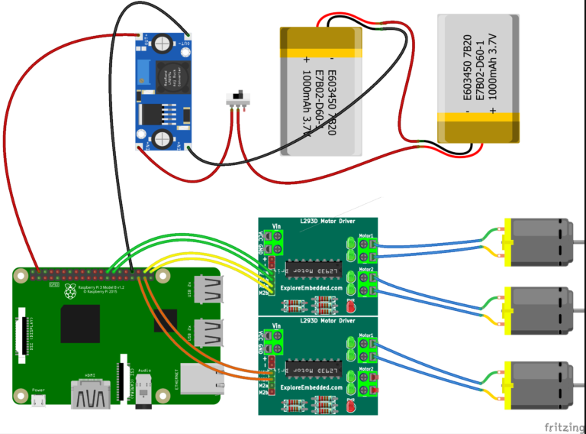
Circuit Diagram of Project

Slide 14
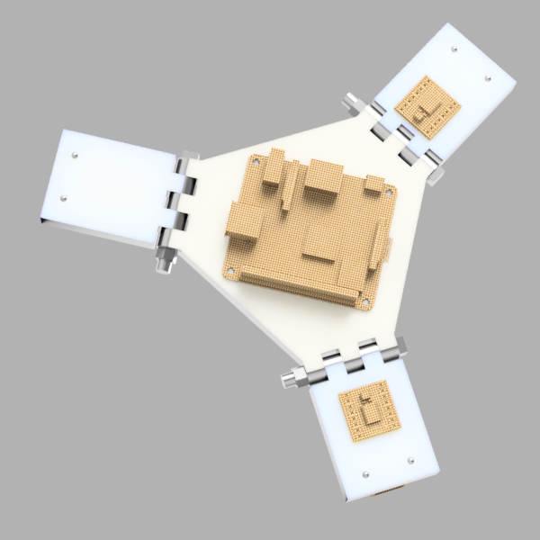
CAD Design of Project

Slide 15
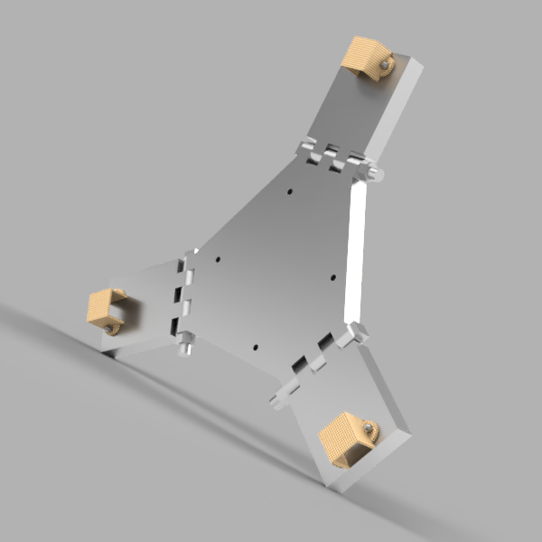
Continued….

Slide 16
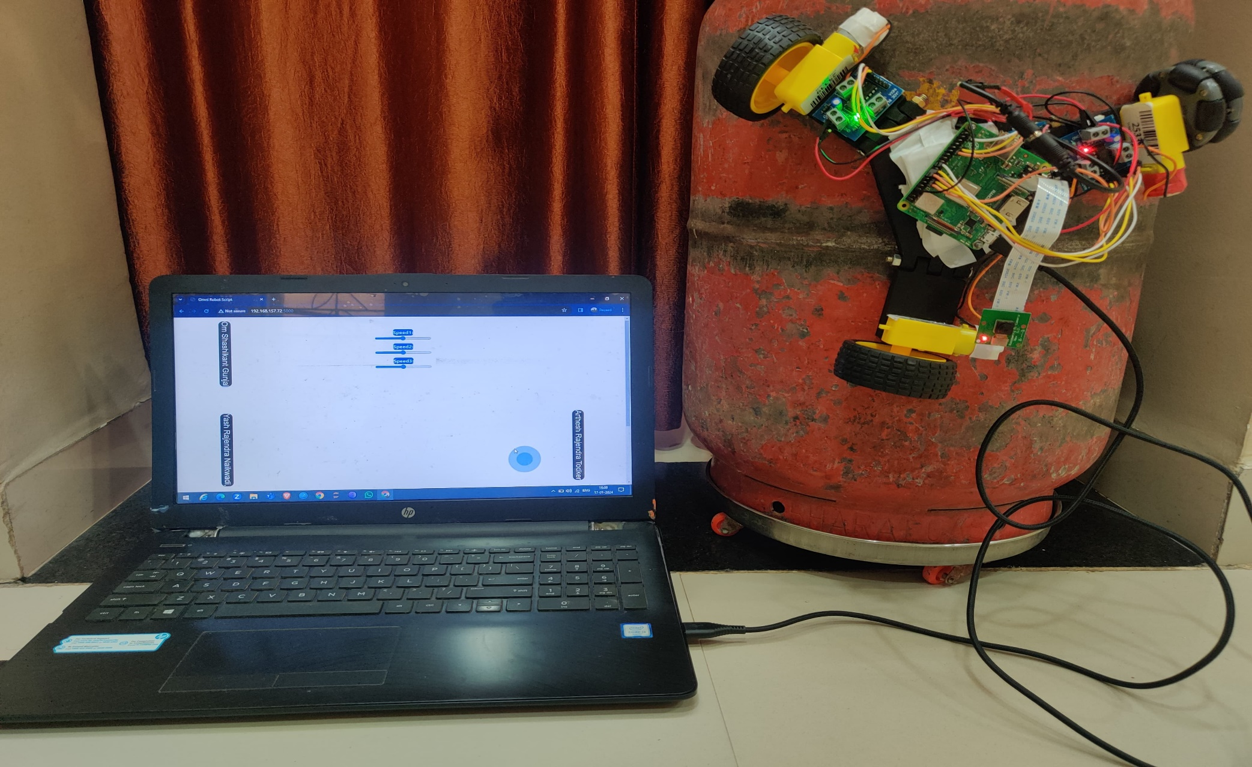
Project Photograph

Slide 17
Individual & Group Contribution Table
Report of Project: Gunjal Om Shashikant
Presentation of Project: Naikwadi Yash Rajendra
Project Work: Naikwadi Yash Rajendra
Gunjal Om Shashikant
Todkar Arthesh Rajendra

Slide 18
Advantages
Autonomous Navigation:
The use of Raspberry Pi allows for the implementation of sophisticated autonomous navigation algorithms, enabling the robot to navigate pipes without constant human intervention.
Cost-Effectiveness:
Raspberry Pi is a cost-effective and widely accessible computing platform, contributing to the overall affordability of the robot compared to more complex systems.
Adaptability to Different Pipe Diameters:
The design can be tailored to accommodate various pipe diameters, making the robot versatile and suitable for deployment in different industrial settings.
Customizable Sensor Suite:
Raspberry Pi provides the flexibility to integrate a customizable sensor suite, including ultrasonic sensors, infrared sensors, proximity sensors, and cameras, enabling comprehensive pipe inspection.
Wireless Communication:
The integration of Raspberry Pi allows for wireless communication (Wi-Fi or Bluetooth), enabling real-time remote control and data transmission, which is crucial for monitoring and controlling the robot in inaccessible or hazardous environments.
User-Friendly Interface:
Raspberry Pi facilitates the creation of a user-friendly interface for remote monitoring and control, enhancing the ease of operation for operators.
Safety Features:
The robot can be equipped with safety features, such as emergency stop mechanisms and fail-safes, ensuring safe operation and preventing damage to the robot or the infrastructure being inspected.

Slide 19
Disadvantages
Limited Processing Power:
Raspberry Pi, while versatile, may have limited processing power compared to more specialized computing platforms. This limitation can impact the robot's ability to process complex algorithms quickly.
Limited Payload Capacity:
Raspberry Pi and the associated hardware may limit the robot's payload capacity, restricting the types and number of sensors or additional equipment that can be carried.
Limited Memory and Storage:
Raspberry Pi models typically have limited onboard memory and storage, which could be a constraint when dealing with large datasets or prolonged data logging.
Limited Operating System Options:
Raspberry Pi primarily runs on Linux-based operating systems. This may limit the choice of operating systems, potentially impacting compatibility with certain software or libraries.
Dependency on Wireless Communication:
While wireless communication is advantageous, dependence on Wi-Fi or Bluetooth introduces the risk of signal loss or interference, especially in environments with electromagnetic interference.
Reliability Challenges:
Raspberry Pi boards might face reliability challenges in harsh industrial environments due to factors such as temperature extremes, humidity, or exposure to contaminants.
Battery Life and Power Management:
Managing the power requirements of the robot, especially during continuous operation, can be challenging. Limited battery life may require frequent recharging or replacement.

Slide 20
Applications
To assist in jobs involving periodic inspections for the detection of cracks, corrosion material degradation and welding defects on tanks and pipes. Gas and oil tanks, wind turbines, pipelines and marine vessels are examples of the structures. Such structures are usually made of ferromagnetic materials and they have a convex circumference.
Sea-going vessels are subjected to a number of inspection and maintenance measures. These also involve a visual and physical inspection of the ship, including cargo holds and tanks. Smaller tanks are often narrow, badly ventilated and dirty.
Larger spaces (e.g. cargo holds) can easily reach the heights of 10 meters and more. Extensive scaffolding, the use of cranes, or other (typically expensive) are needed in order to reach to the latter. This further makes the inspection of ships a time consuming, expensive and potentially dangerous task.
Operation in such environments are dangerous and a great amount of manpower and time is required. Automating such tasks with pipe climbing robot could help in large savings in terms of monetary. It also helps to save the time that is otherwise required to install scaffolding or extra structures to reach higher heights.

Slide 21
Project Plan / Schedule (Gantt chart)
Task Name | Jul 2023 | August 2023 | Sep 2023 | Oct 2023 | Nov 2023 | Jan 2024 | Feb 2024 | March 2024 | April 2024
Team Members Selection |  | 25 August
Searching for Projects |  |  | 9 Sept to 25 Sept
Finalizing the Title of Project |  |  |  | 5 October
Synopsis of Project |  |  |  | 13 October
Presentation of Project |  |  |  |  |  |  |  |  | 27 May

Slide 22
Conclusions
Robots have been extensively used in various industries in the recent times. They help increases efficiency and reduce the risks that humans would have to face in certain work environments.
The ferromagnetic pipe climbing can be used with a similar thought in mind. It can climb pipes, avoid installing scaffolds and reduce the risks on human lives. The robot can climb vertical pipes and help in the detection of surface defects. The following conclusions can be drawn:
It can climb pipes with a minimum diameter of 0.2m and flat surfaces.
It has been tested to climb a height of 4m.
It can be controlled on multiple devices.
Images can be captured and a live video feed can be seen.
The batteries are rechargeable and can last for 1800 s to 2700 s.

Slide 23
Future Scope
Enhanced Autonomy:
Future iterations can focus on improving the robot's autonomous navigation capabilities through the incorporation of advanced machine learning algorithms and computer vision. This could enable the robot to adapt to changing pipe conditions and make more informed decisions during inspections.
Advanced Sensor Integration:
Integration of cutting-edge sensors, such as advanced imaging systems, gas detectors, or multispectral sensors, can enhance the robot's ability to detect a wider range of anomalies, providing more comprehensive inspection data.
Machine Learning for Anomaly Detection:
Implementing machine learning algorithms for anomaly detection can enable the robot to identify and classify different types of defects or irregularities in the pipeline structure, improving the accuracy of inspections.
Multi-Robot Collaboration:
Future developments may involve the coordination of multiple climbing robots working collaboratively to inspect and maintain extensive pipeline networks efficiently. This can lead to faster inspections and increased coverage.
Improved Magnetic Adhesion Systems:
Research and development efforts can focus on designing more robust and adaptable magnetic adhesion systems that can securely attach to various pipe materials, shapes, and conditions.

Slide 24
References
https://www.arnabkumardas.com/platforms/raspberry-pi/ferromagnetic-pipe-climbing-robot
https://www.arnabkumardas.com/platforms/raspberry-pi/
https://www.arnabkumardas.com/

Slide 25
Thank you…

